Slide 1
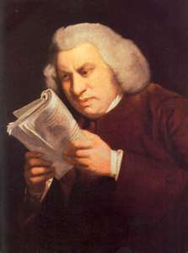

The Samuel Johnson Challenge
How much do you need to know?

Slide 2

Whatcha’ doin’?
Some review
Why do we get paid?
How do our brains work?
What is knowing?
How do we learn?
Knowledge is of two kinds. We know a subject ourselves, or we know where we can find information upon it.
What does this statement mean in the context of how we now understand our mind works?

Slide 3
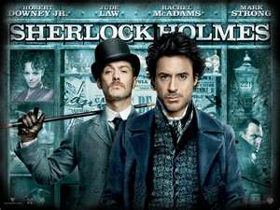
What I am going to try to prove
You shouldn’t try to be an expert on everything
Need to have large broad superficial knowledge of new technologies and know when to quit
How you learn effects how you know
Everything you learn changes you
A certain type of knowledge is best
But certain type of knowledge only comes from experience

Slide 4
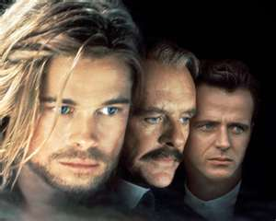

Caveats then review
I believe learning is a good in itself
I will be arguing don’t need to learn everything
But it is NOT an argument against learning for sheer enjoyment
Legends of the Fall
“What would she do with all this education?”
“She would lead a richer, fuller life”
But first, Why do they pay us?

Slide 5
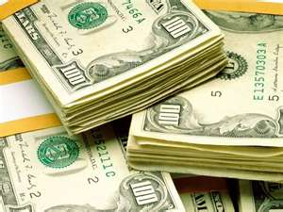
Show me the money
Programmers create value by making tasks faster and more accurate
Capital investment to cut down on future wages
Programmers have knowledge (capital)
Capital Assets lose value over time
You can’t rest on your current knowledge
Always need to know more stuff

Slide 6
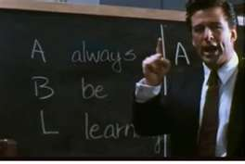
What should we do about this?
Always Be Learning
Use tools for speed and accuracy
Think “how can I make this better?”
So the question becomes “what should I learn?”
Before we answer that…
Let’s talk about how we think

Slide 7
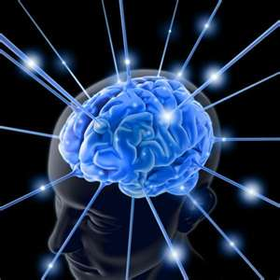
How do we think?
Type 1-non conscious
Unstoppable-priming
Fire together, wires together
Effortless
Type 2- conscious
Voluntary
Lazy
Effortful

Slide 8
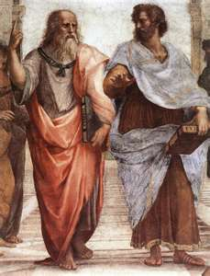
What is knowing?
Not going to go down Epistemology road
Ok, maybe a little but that is later
Knowing in context here
Existence of concrete items in objective world
Knowing is awareness of those items to be able to
React to this knowledge
Make predictions
Manipulation the environment

Slide 9
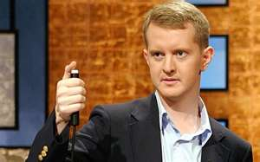
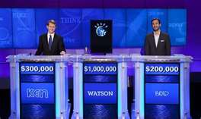
What knowing isn’t
Having perfect recall
Having an official answer
Having perfect knowledge of the objective world
Remember facts doesn’t make knowledge

Slide 10
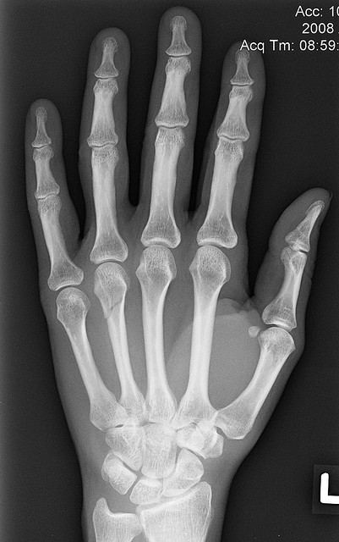
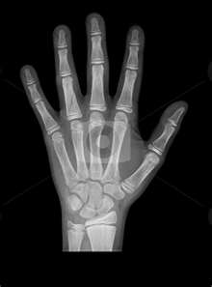
Facts to knowledge
What is this?
Is this hand broken?
Use a splint?
Need an operation?

Slide 11
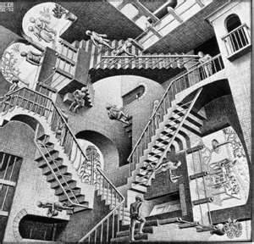
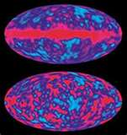
Here is the background
You know there are xrays and have seen them
You know what your hands look like
We can recognize a pattern and spot difference
Knowledge is knowing what that pattern difference means and what to do about it

Slide 12

What’s wrong with this code?
if ($foo > 50) { include("myfuncs.php"); } if ($foo > 100) { include("myfuncs.php"); }
Do you know PHP?
How did you solve it?
Pattern recognition is mostly a Type 1-non conscious process but not always

Slide 13

So in summary
We use pattern recognition to view the world
Sometimes our lack of detailed facts doesn’t lead to knowledge (xray)
Sometimes we don’t need detailed facts to have knowledge (php)

Slide 14

Bucket-near
Given facts, we put them in our mental buckets
Once in buckets we evaluate them
So one of the important things to know is how are these buckets formed?
We form mental categories

Slide 15
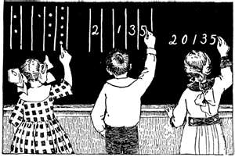
Everything in its place
Categories are not objective but human creations
What is a game?- Wittgenstein
Poker
Football
Monopoly
Jump Rope
Tag

Slide 16
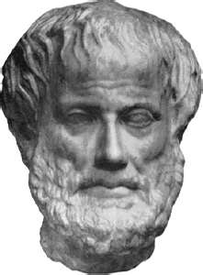
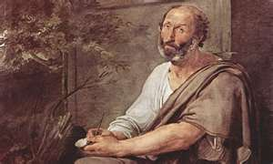
So what is a category?
Dad?
Categories are not a list of adjectives
Aristotle-dead wrong
Categories are a “family” resemblance
And some items are just better examples of a category

Slide 17
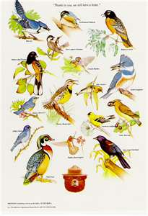
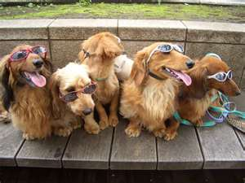
Some items are just more so…
Birds
Penguins
Robins
Dogs
Poodle
German Sheppard
Chihuahua
Grey Wolf?
Languages
English
Spanish
PHP

Slide 18
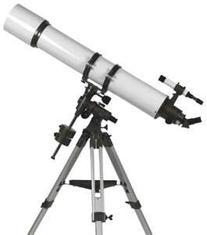
Quick peak ahead
Learning the best example of a concept gives you a good place to expand
So how you first are introduced to a topic can effect your ability to learn details

Slide 19
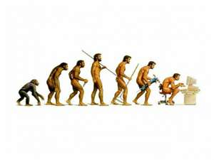
Blame Evolution
Brain is a prediction machine of events
Your brain evolved to take advantage of environment
Did not evolve to understand reality
Evolved to solve problems
Brain uses the categories it creates non-consciously

Slide 20
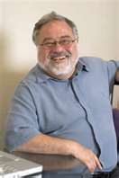

Lackoff
Humans’ use categories for metaphors
Human knowledge is always a metaphor
Most of these items are non-conscious metaphors
Steven Hawking- Problem of understanding big bang is our belief in objective time

Slide 21
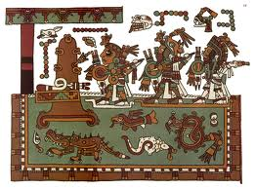

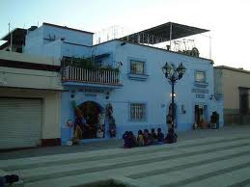
Metaphors are not consistent between cultures
What is the back of the house?
Mixtec
House as animal metaphor
Back of house is Top from our metaphor
He is tanning on the house’s back
Can translate truth value but not all of statement

Slide 22

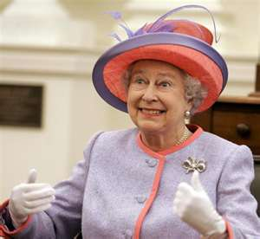

Categories determine thought
Guugu Yimithirr-Only cardinal directions
How to set up the table for queen of England?
Categories (and metaphors) help set up possible thoughts
In 1811-Bat was slang for prostitute

Slide 23
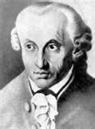
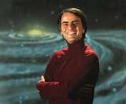
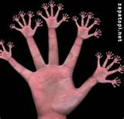
The deadly metaphor –framing problem
* What is intuitive is natural
Kant- Egocentric directions are natural
Sagan- 10 base system due to human finger count
Both really smart-both really wrong
Lakoff-important to save endangered languages
Notes:
Deutscher- Through the Looking Glass: Why the World Looks Different in Other Languages 2900
Sagan- Dragons of Eden

Slide 24


Grammatical Gender
Gender of words in languages (la luna, el jeffe)
Not just gender, also animate, inanimate, etc.
The way we split up the world is not really the way the world is split up

Slide 25
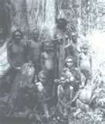
Women, Fire and Dangerous Things
Dyirbal
I – animate objects, men
II – women, water, fire, violence
III – edible fruit and vegetables
IV – miscellaneous (includes things not classifiable in the first three)

Slide 26
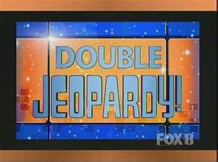
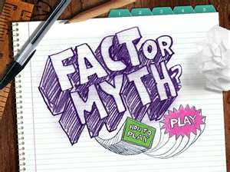
Creation of categories
Note these came about from Myths
As myths vanish in importance, the ability to use proper grammar declined
Perfect example of Type 1 learning
You don’t know that you know

Slide 27
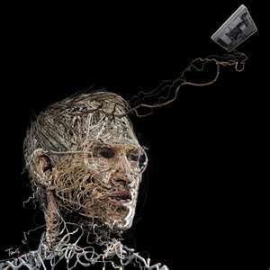
I know even though I don’t
Creativity is just connecting things.
When you ask creative people how they did something, they feel a little guilty because they didn't really do it, they just saw something.

Slide 28
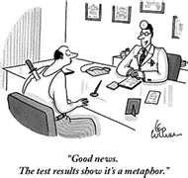
Good metaphors
Our ability to predict and manipulate is based on our metaphoric capacity
Many metaphors for single concepts blend
Passage of time
How long ago was it?
What are you looking forward to?
Do have time?

Slide 29


The good hands people
Example of how metaphor can solidify ideas
“The internet’s constant stimuli makes people need more powerful stimuli to grab their attention.”
“The internet’s constant stimuli numbs your mind.”
“The internet’s constant splinters of stimuli creates a mental callous allowing you to only feel the most prickly of stimuli.”

Slide 30
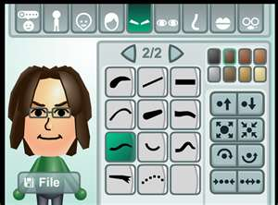
The point…
You create your categories to evaluate things
You use metaphors to extend your knowledge
The metaphor systems you have in place can help (or hurt) your understanding
So how do you create categories?
You create them in your learning process

Slide 31
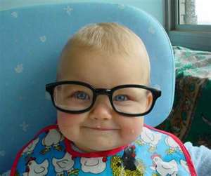
How do I learn?
Learning is acquiring information that allows you to predict and manipulate the real world
We all learn better in different ways

Slide 32
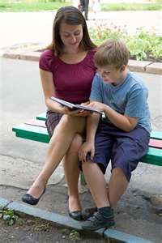
Types of learning
Verbal
Aural
Written
Imagery
Active
Tactile
All invoke unconscious learning in some way

Slide 33
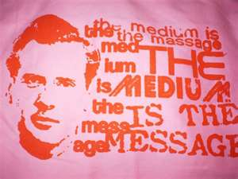
Ways of conscious learning
Marshall McLuhan
The Media is the Message
Proven true in a way
Written or heard text is not processed the same

Slide 34
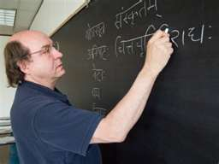
Methods of learning
Course of study
Defined sequence of items
Examples
Defined sequence of items
Hunter Gathering
Web based without known sequence

Slide 35

What should I do?
Follow your bliss
Find a yogi/teacher/mentor in the form you learn best from
Memory tricks use what you know to link to other things you know
Sometimes we don’t understand without linking to something we already know

Slide 36
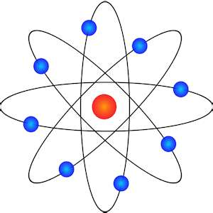
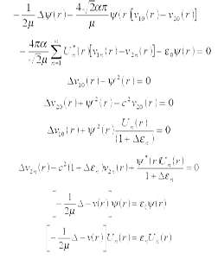
Atom model
Planet model
easy to understand
Probability waves than jump from place to place without going to the points between the places
not so easy to understand
without math

Slide 37
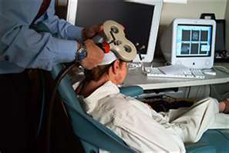
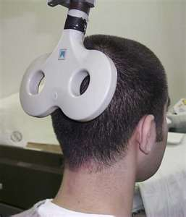
Learning changes your brain
Anything you do/learn changes your brain plasticity
Braille example
Touch takes over optic center
Magic wand takes away ability to understand

Slide 38
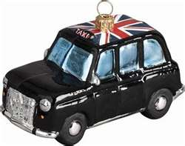
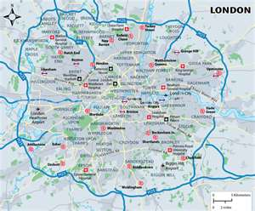
London Taxi Cabs
Takes 2 years to get license
Complex road system
Brains grew to get knowledge (Hippocampus)
Brains shrunk other parts
Intuitive grasp of time, location externalities

Slide 39

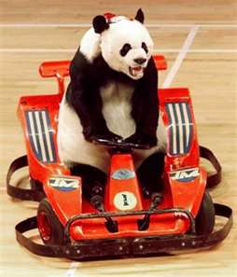
Let’s imagine driving
Driving can be unconscious
But it is obviously learned
Type 2 knowledge becomes Type 1
Aristotle Second Nature

Slide 40
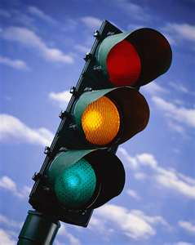
Red means stop
Imagine you see a red light in front of you, what do you do?
Verbal overshadowing
Link of category to concrete actions
You created your memory to answer the question

Slide 41

Bugs in my way
Ever had a bug come at you in the windshield?
Did you duck?
Why didn’t you use your hands as you would if you weren’t driving?

Slide 42

Conclusion of this nonsense
Items can be learned to enhance your ability to predict and manipulate items (knowledge) without your conscious consent
Sometimes this is useful and can’t be substituted by conscious knowledge

Slide 43
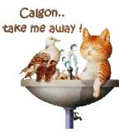
Calgon take me away
So if everything we do effects everything else we learn latter, what are we supposed to do?
How will we know is best for us?
You don’t and I sure don’t know
But we can do a strategy to optimize our chances

Slide 44
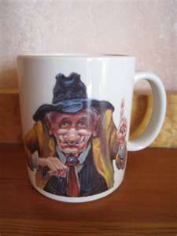
My advise
Manage risk and eliminate uncertainty
Be a quitter
Know how you learn
Deepen expertise
Expand queue-able knowledge
Let’s go more in depth with each item

Slide 45

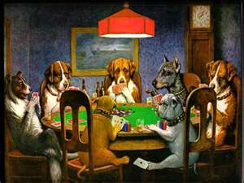
What is risk?
Risk is the assessment of probabilities with uncertain facts
You always have unknowns
Life is not a chess match
It is a game of poker

Slide 46

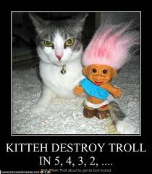

What is uncertainty?
Uncertainty is lack of awareness of how any facts can effect you
You cannot assess it
You troll to destroy it
You never can fix it in total

Slide 47

Risk vs. Uncertainty
Uncertainty can harm you without your knowledge
Smoking in the 50s
MS Developer in 2003 who never heard of .NET
Usually leads to law suits because of confusion with risk or not doing a study to assess risk

Slide 48

Risk is determining the following:
What does this technology do and when would I use it?
What is the probability that this will replace what I do?
What does this new technology do faster than my current method?
Experts are best judge of risk

Slide 49
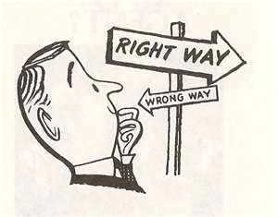
What is an expert?
An expert is someone who understands a subject in a many layered way
For example- ASP Controls
Layer 1-When to Use Them
Layer 2-How to Use Them in Generic ways
Layer 3-How to customize them
Layer 4-How to create them
Layer 5-Jeopardy Level-know obscure facts

Slide 50

Code is a many layered thing
It is good to have a Layer 1 knowledge of all new technologies
Can answer the question “When do I use x new technology?”
It is good to know about other technologies because you eliminate uncertainty and replace it with risk
You don’t have to be any expert, just manage risk

Slide 51

What shallow knowledge?
Android
iPhone
iPad
Google API
Amazon Web Services
MVC
Java
Objective C
NoSQL

Slide 52

Read code
The easiest way to become a better programmer is to read code
Hundreds of open source online projects
Hundreds of books in Safari subscription in the library
Skillsoft/24x7books
Itunes U
Let code seep into you body

Slide 53

But why shallow?
Law of Diminishing Marginal Utility
You always will reach a point in any process where the marginal returns will lessen for the same effort
You can’t feed the world from a flowerpot
You get the most bang for your buck early
The more expert you become, the more work it takes to add something new to your base

Slide 54

Practical Example of Shallowness
LINQ to XML
Don’t know it
But superficial knowledge allows me to know it is out there by reading a book through without doing every exercise
Was able to point Joe to book
Joe was able to master it and sent me example

Slide 55



Quitting is good
Freakanomics Blog
You get no points for sticking with a technology that doesn’t help you
Beware of sunk-cost fallacies
Movie Theatre ticket example
So be a quitter

Slide 56

Quit after you try though
And the trying of course is the process of learning

Slide 57

What learning isn’t
Memorizing factoids
Gathering random facts
Learning facts without a scaffolding leads to not being able to be apply their consequences
You can’t learn from Google search
Have to be able to put it in context

Slide 58

Ways to learn on telerik.com
Written documentation
Examples with code
Videos
Blogs
Support Forums
Emails

Slide 59

Things to learn
Go deeper with expertise
Controls to replace tasks you do over and over
Tools that make you faster to market
What about a language?
It depends

Slide 60

Should I learn a new language?
Does it up your capital value?
Yes
It is a language that is an important technology that will become more important?
Objective C
Can give you another metaphor to use
Memory tricks
No
Anything else
Beware of toy languages

Slide 61
Why do I care?
Knowledge is of two kinds. We know a subject ourselves, or we know where we can find information upon it.
Not quite…
What?

Slide 62
What Sammy didn’t know
We have knowledge of different ways to react to bugs depending on context
We have knowledge of how to drive without thinking
We know things we aren’t aware of
Everything you learn changes you
This has to be wrong!

Slide 63

Google lets you know small facts
Can find knowledge in a better way than Johnson could have dreamed
For example-obscure error message
But no amount of facts creates knowledge without a metaphoric framework
You can’t learn from Google search

Slide 64

So what you learn is …
What you become
Parts of your learning are not under your control
Looked up knowledge is a different kind of knowledge
Better in permanence
Lesser for creativity

Slide 65
Problems with Sam’s view
Some internal knowledge cannot be totally replaced with external knowledge because Type I is just better
Knowing where something is has a time factor
And remember what we developers do…
(save time)

Slide 66

Mick Jaggar is a liar
Time is not on our side
Time searching for needed information diminishes your value
Time is a factor of knowledge
But we can’t know everything
The key is knowledge depth

Slide 67

Knowledge depth
Knowledge depth is the amount of details you know on a subject before needing assistance
Think of the following
Wikipedia- has general knowledge
Source documents- have more detailed knowledge
Scholarly documents-have minutia
Creation knowledge-private copywriter details

Slide 68

Making up some terms
Knowledge Levels
Unaware-Prolog
Aware- MySQL
Basic- MSSQL
Source-CLR
Scholarship-Algorithm
Minutia- Machine Language
Obscured-Hidden Markov Model Language Processing

Slide 69

Which means…
Impossible to know unaware vs. obscured
Wikipedia can move some to awareness
Some items have a time horizon (obscured)
Your mind can hold more knowledge with optimal metaphor system
C# to Objective C

Slide 70

This is not a quiz-silence please
A customer wants to show a list of majors
What can you do?
The customer wants to show more details when you select a major
What can you do?
The customer wants to allow user to sort on different properties of the major
What can you do?

Slide 71

What you did
You consulted your bag o’ tricks first
Basic knowledge
Could asp.net controls, telerik, jquery, etc.
Second one changes the answer a little and requires more detailed knowledge
Source knowledge
Third one requires you to probably start over
This requires a change of scope

Slide 72

Search the shallow pond
Can you think of something new that could accomplish these tasks?
If so, can you assess the risk
P (speed of current) < P(speed of learning) + P(speed of new method)
If larger solution and multiple use, the cost of learning is lowered

Slide 73

Types of Basic Knowledge
Non conscious – basic programming logic
Actionable-Can write from memory
Queue-able- Items not in memory but tools can find in real time with minimal effort
Deep knowledge- understand the how of items work through multiple layers
Researchable-need to lookup information

Slide 74

Queue-able
Queue-able knowledge is the key to success
Queue-able knowledge is knowledge that can be called up with minimal effort
Visual Studio
SQL Prompt
Designer Toolbox
Automation

Slide 75

The key to the kingdom
What two tasks always follow each other?
If X then Y
Find a way to automate Y when you do X
Snippets
Abstraction levels
Or if Y then do X
Imports is best example in c#

Slide 76


Think lazy
Developers are odd combinations of lazy people who want to spend lots of time learning things
Always keep an eye out for repetition
Visual Studio is the Yoda of this type of thinking
Use the force

Slide 77

What I tried to prove
Knowledge is much more complex than Samuel Johnson knew
Everything we learn will effect how we learn everything else we learn later
It even changes your brain
We all learn differently
You need to figure out how YOU learn

Slide 78

Know nothing
We can’t know everything
We should be superficial learners in areas outside of our expertise
and bloodhounds in our expert domains
This allows us to manage risk and eliminate uncertainty

Slide 79

Build it up
We should make efforts to increase our queue-able knowledge
Use tools to code with less effort
Look for repetition and automate it

Slide 80

And that’s all I have to say about that…

